Slide 1
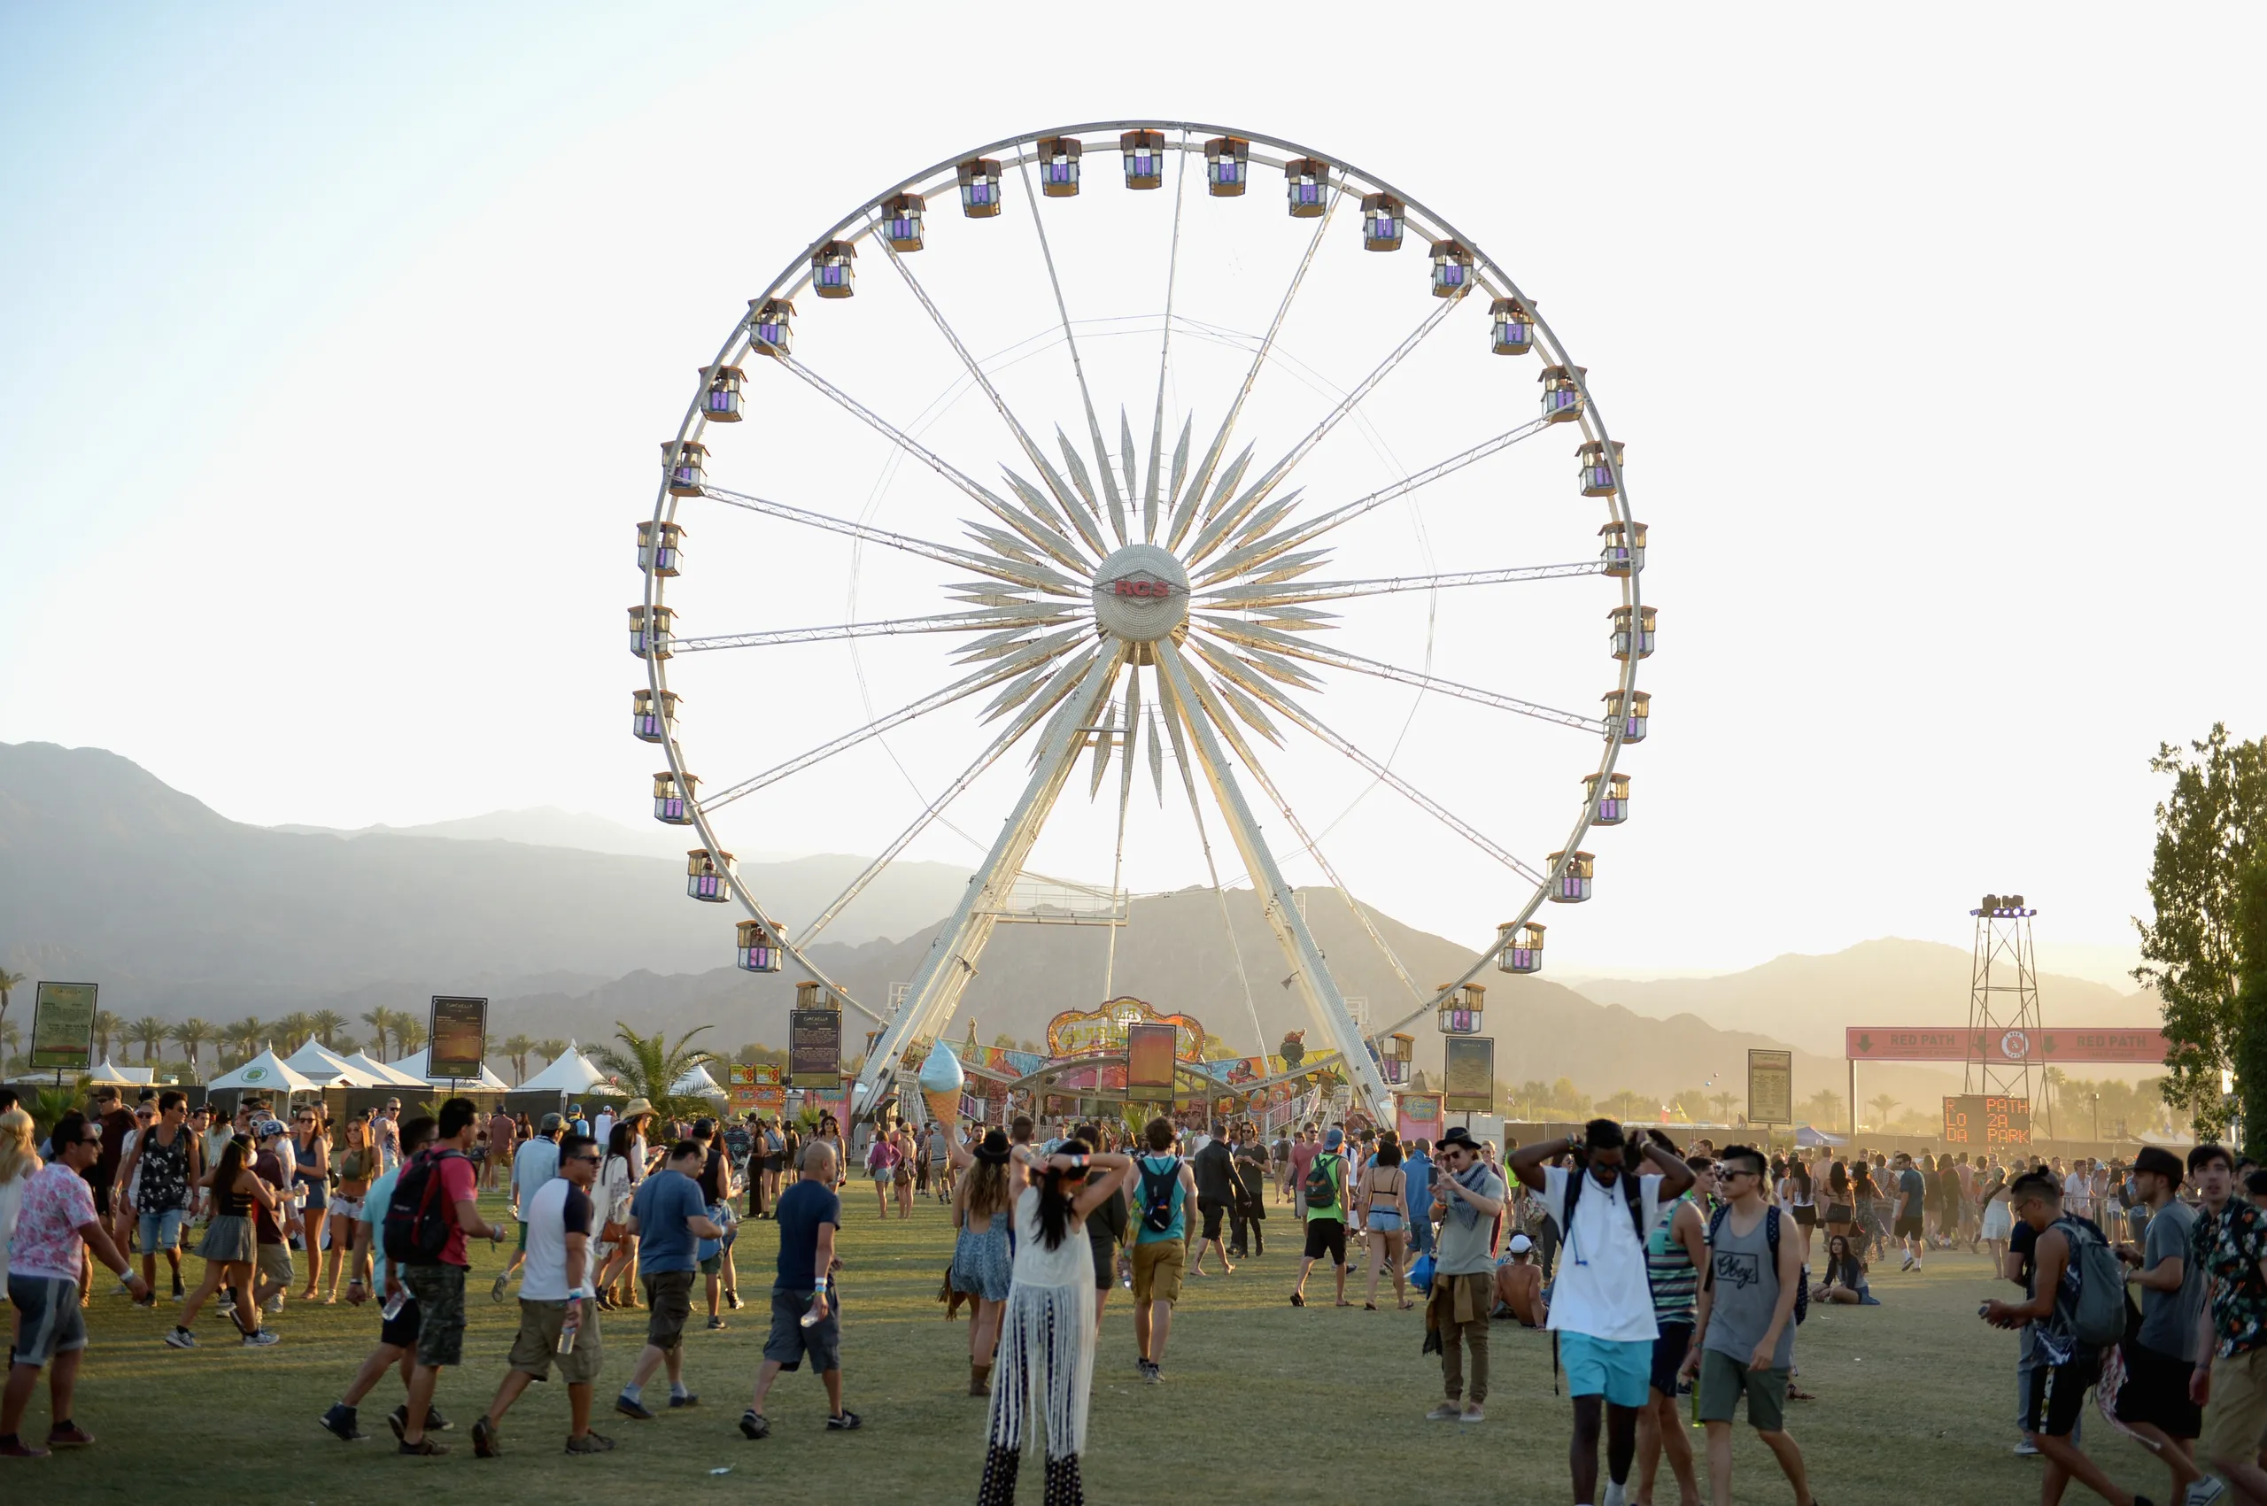

COCKTAIL & NETWORKING
DECEMBER 11TH
INTRO
PRE-TRADE STAGE | 05:05PM
●
ROCK’N’ROLL FT HIP-HOP
POP FT ELECTRO
EXECUTION STAGE | 05:10PM
●
ROCK’N’ROLL FT POP
HIP-HOP FT ELECTRO
POST-TRADE STAGE | 05:20PM
●
QUIZ
BREAKOUT STAGE | 05:30PM
●
FULL MASH UP
AFTER-HOURS STAGE | 05:40PM

Slide 2
COCKTAIL & NETWORKING
DECEMBER 11TH
INTRO
PRE-TRADE STAGE | 05:05PM
●
ROCK’N’ROLL FT HIP-HOP
POP FT ELECTRO
EXECUTION STAGE | 05:10PM
●
ROCK’N’ROLL FT POP
HIP-HOP FT ELECTRO
POST-TRADE STAGE | 05:20PM
●
QUIZ
BREAKOUT STAGE | 05:30PM
●
FULL MASH UP
AFTER-HOURS STAGE | 05:40PM

Slide 3
COCKTAIL & NETWORKING
DECEMBER 11TH
INTRO
PRE-TRADE STAGE | 05:05PM
●
ROCK’N’ROLL FT HIP-HOP
POP FT ELECTRO
EXECUTION STAGE | 05:10PM
●
ROCK’N’ROLL FT POP
HIP-HOP FT ELECTRO
POST-TRADE STAGE | 05:20PM
●
QUIZ
BREAKOUT STAGE | 05:30PM
●
FULL MASH UP
AFTER-HOURS STAGE | 05:40PM

Slide 4
COCKTAIL & NETWORKING
DECEMBER 11TH
INTRO
PRE-TRADE STAGE | 05:05PM
●
ROCK’N’ROLL FT HIP-HOP
POP FT ELECTRO
EXECUTION STAGE | 05:10PM
●
ROCK’N’ROLL FT POP
HIP-HOP FT ELECTRO
POST-TRADE STAGE | 05:20PM
●
QUIZ
BREAKOUT STAGE | 05:30PM
●
FULL MASH UP
AFTER-HOURS STAGE | 05:40PM

Slide 5
COCKTAIL & NETWORKING
DECEMBER 11TH
INTRO
PRE-TRADE STAGE | 05:05PM
●
ROCK’N’ROLL FT HIP-HOP
POP FT ELECTRO
EXECUTION STAGE | 05:10PM
●
ROCK’N’ROLL FT POP
HIP-HOP FT ELECTRO
POST-TRADE STAGE | 05:20PM
●
QUIZ
BREAKOUT STAGE | 05:30PM
●
FULL MASH UP
AFTER-HOURS STAGE | 05:40PM

Slide 6

COCKTAIL & NETWORKING
DECEMBER 11TH
INTRO
PRE-TRADE STAGE | 05:05PM
●
ROCK’N’ROLL FT HIP-HOP
POP FT ELECTRO
EXECUTION STAGE | 05:10PM
●
ROCK’N’ROLL FT POP
HIP-HOP FT ELECTRO
POST-TRADE STAGE | 05:20PM
●
QUIZ
BREAKOUT STAGE | 05:30PM
●
FULL MASH UP
AFTER-HOURS STAGE | 05:40PM
PRE-TRADE
STAGE

Slide 7
COCKTAIL & NETWORKING
DECEMBER 11TH
INTRO
PRE-TRADE STAGE | 05:05PM
●
ROCK’N’ROLL FT HIP-HOP
POP FT ELECTRO
EXECUTION STAGE | 05:10PM
●
ROCK’N’ROLL FT POP
HIP-HOP FT ELECTRO
POST-TRADE STAGE | 05:20PM
●
PRE-TRADE
STAGE
QUIZ
BREAKOUT STAGE | 05:30PM
●
FULL MASH UP
AFTER-HOURS STAGE | 05:40PM

Slide 8
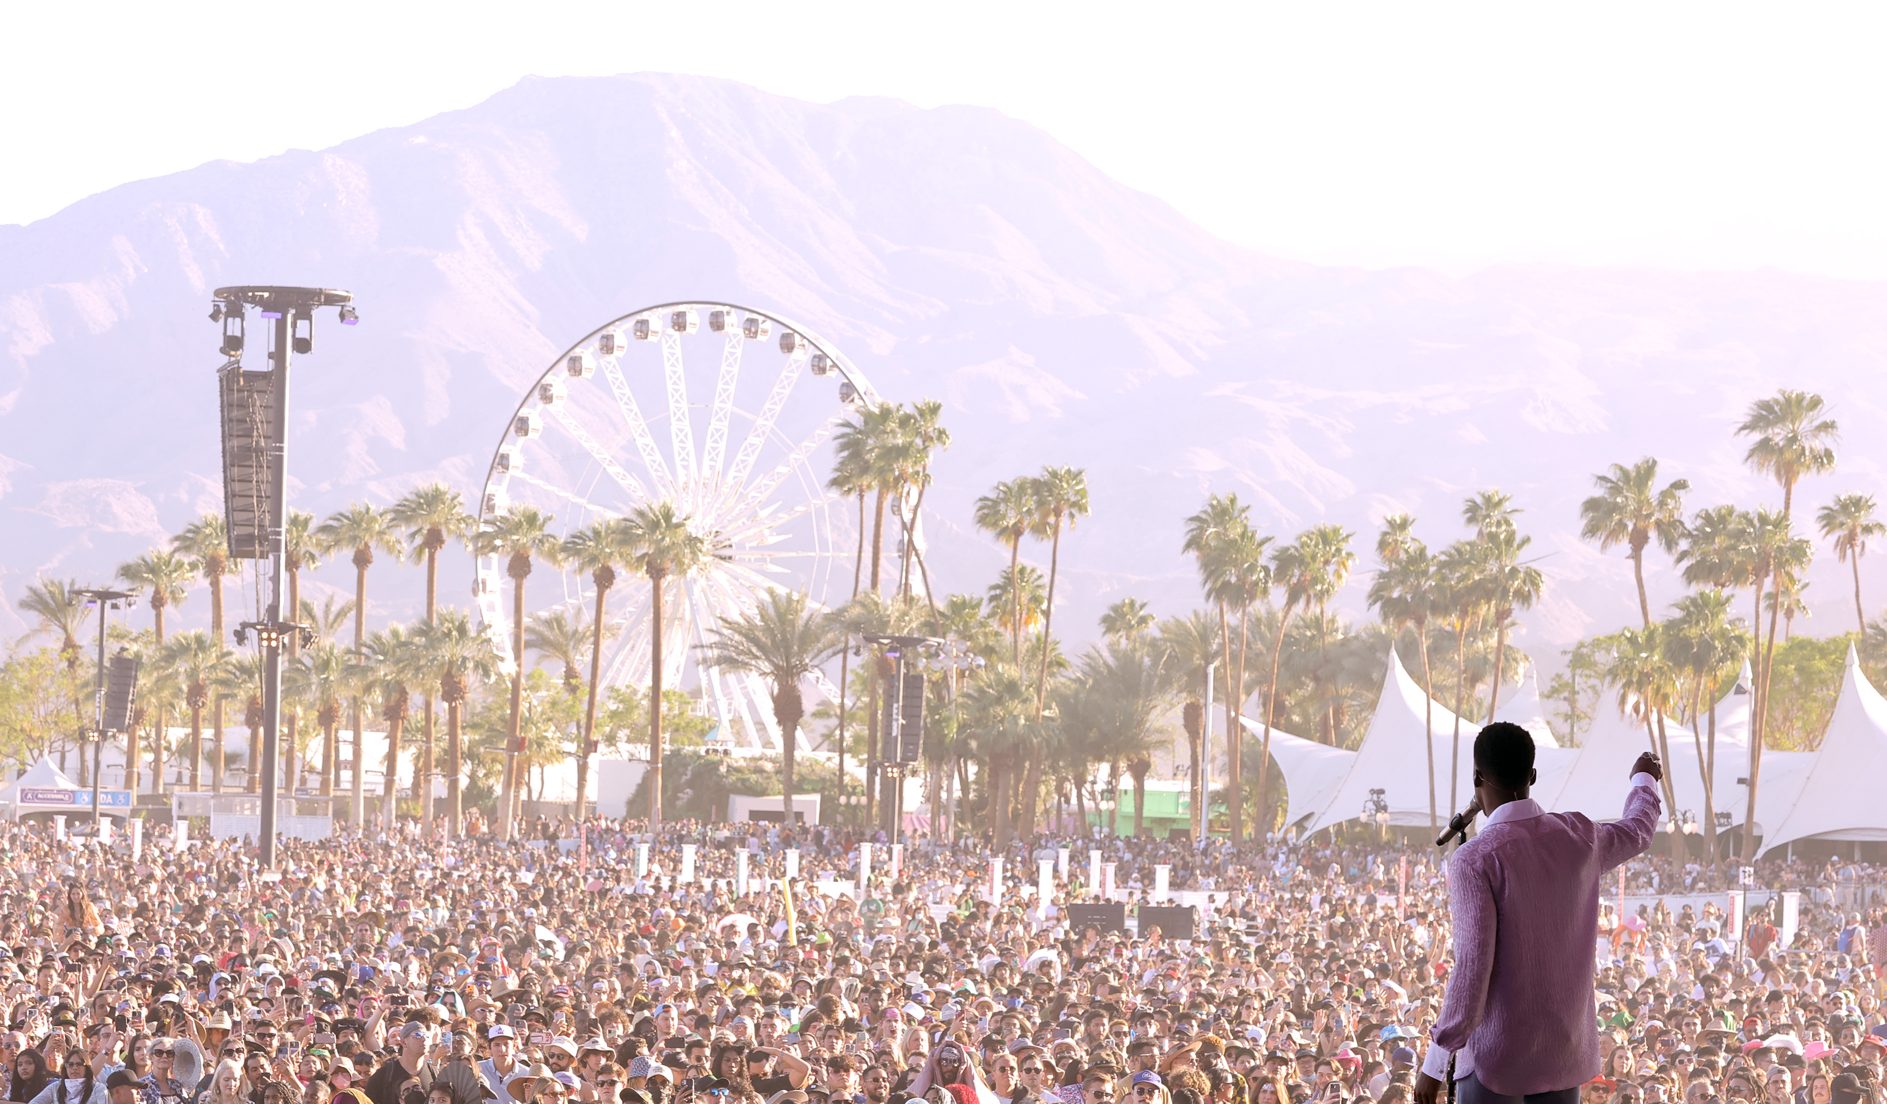

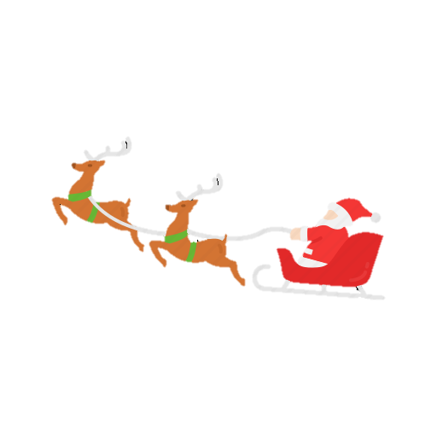










COCKTAIL & NETWORKING
DECEMBER 11TH
ROCK’N’ROLL FT HIP-HOP
POP FT ELECTRO
QUIZ
ROCK’N’ROLL FT POP
HIP-HOP FT ELECTRO
INTRO
FULL MASH UP

Slide 9
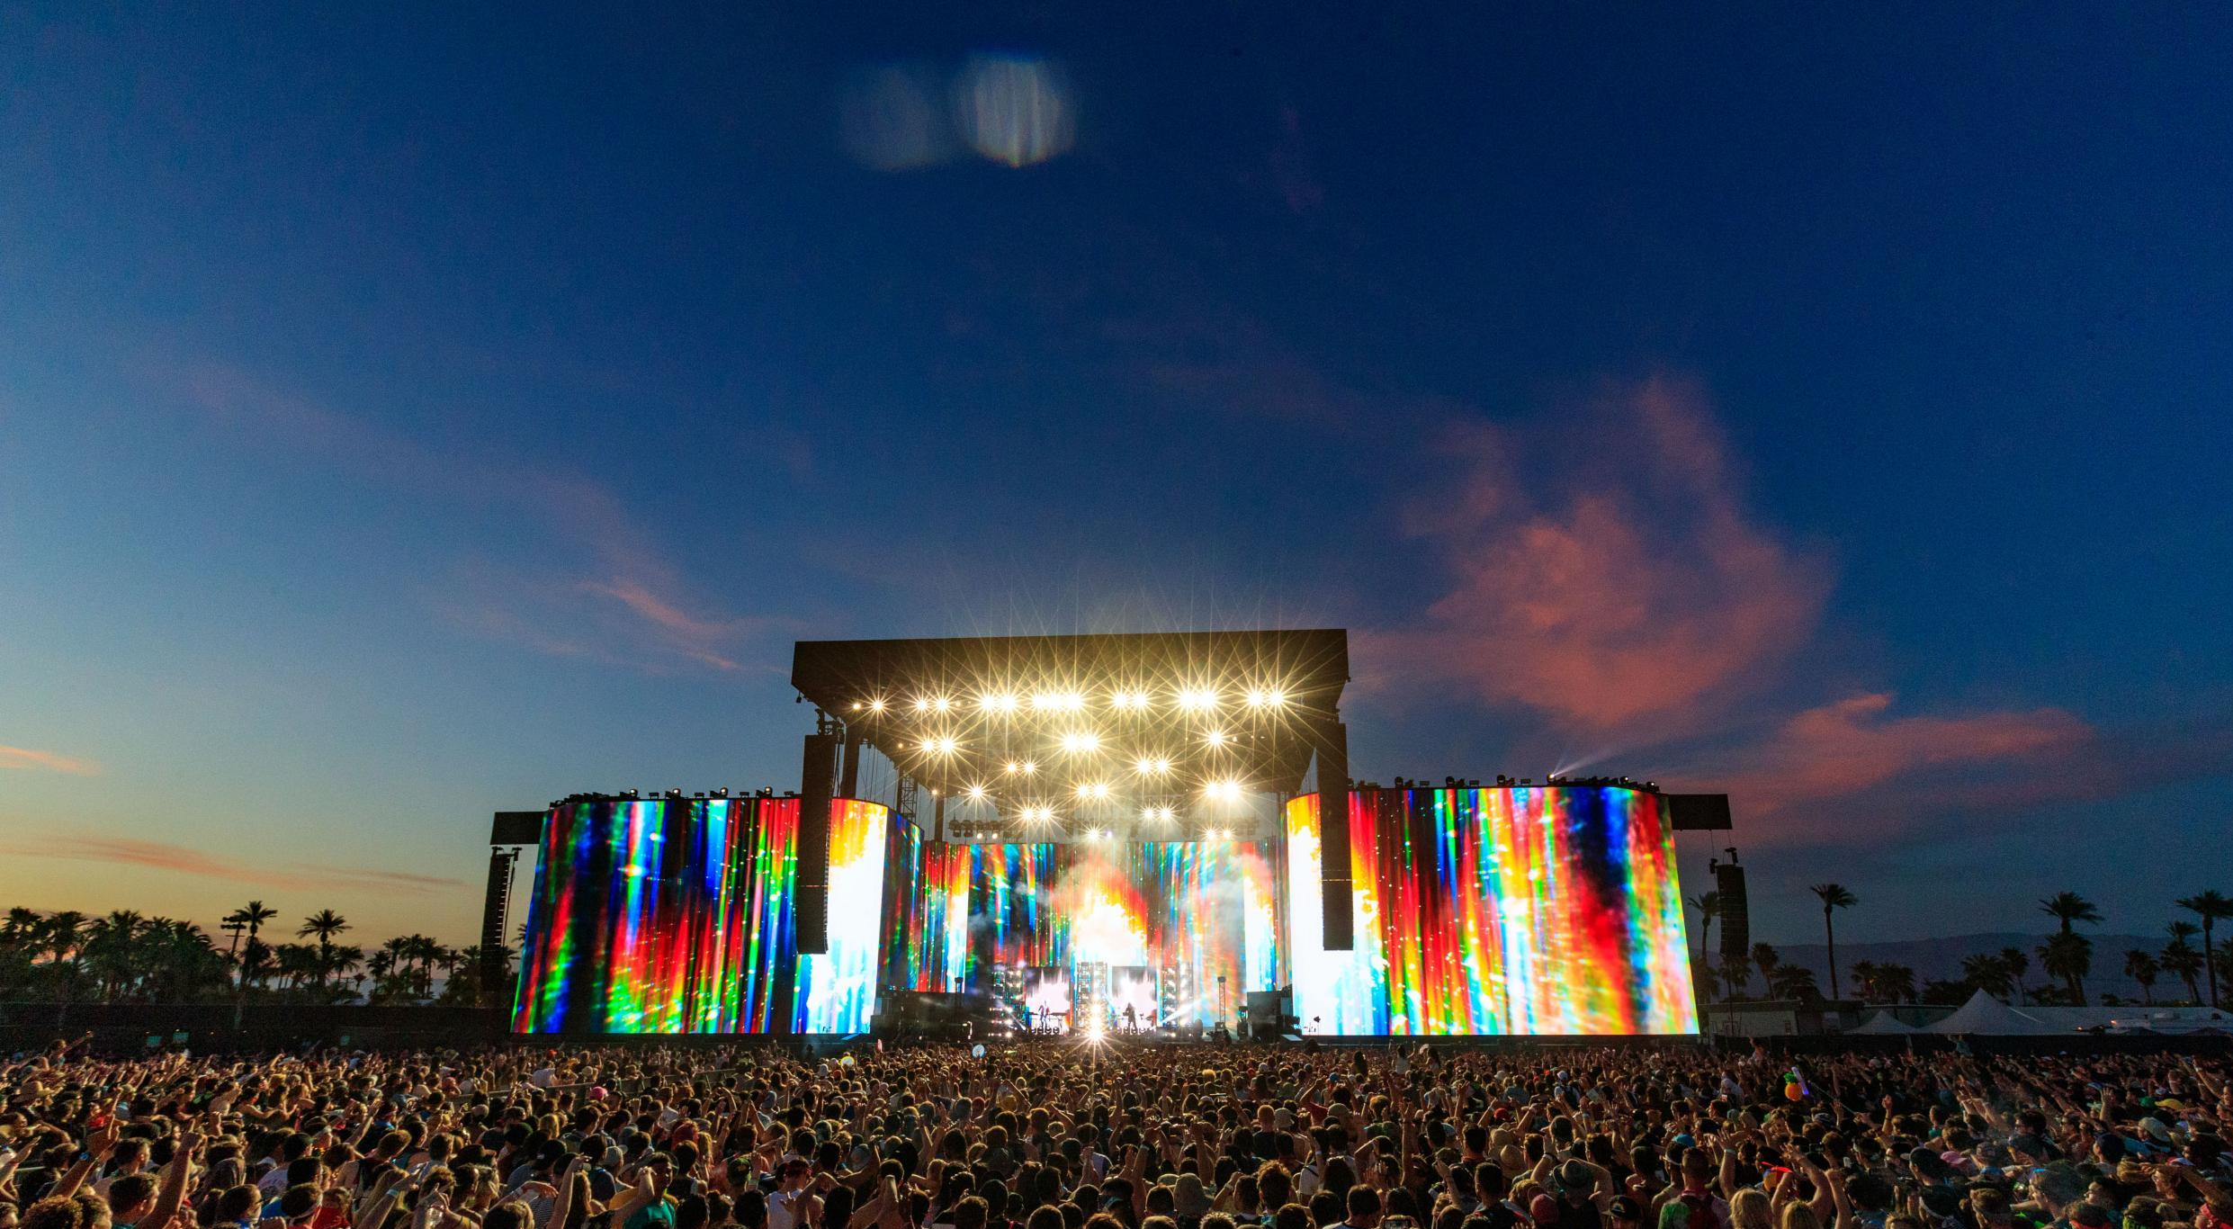


COCKTAIL & NETWORKING
DECEMBER 11TH
ROCK’N’ROLL FT HIP-HOP
POP FT ELECTRO
QUIZ
ROCK’N’ROLL FT POP
HIP-HOP FT ELECTRO
INTRO
FULL MASH UP
FOCUS ON YOURSELF
NOT FOLLOW UP
YES OR NO ANSWERS
DROP THE MIC

Slide 10
COCKTAIL & NETWORKING
DECEMBER 11TH
ROCK’N’ROLL FT HIP-HOP
POP FT ELECTRO
QUIZ
ROCK’N’ROLL FT POP
HIP-HOP FT ELECTRO
INTRO
FULL MASH UP
EXECUTION STAGE
ROCK’N’ROLL FT HIP-HOP
POP FT ELECTRO

Slide 11
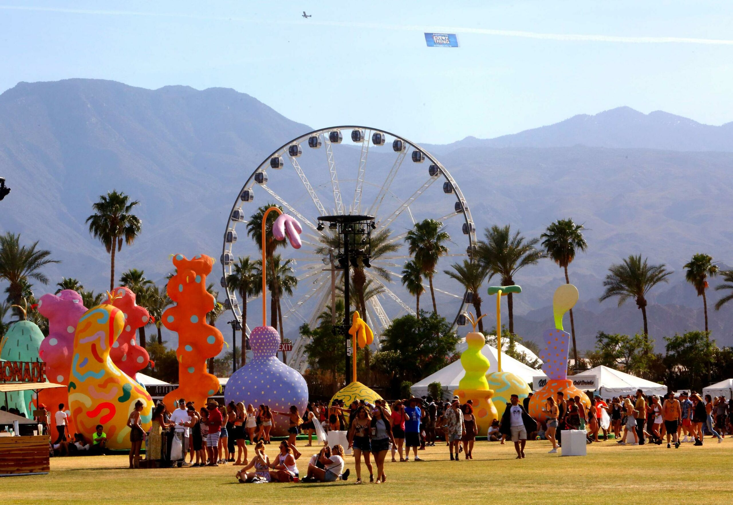
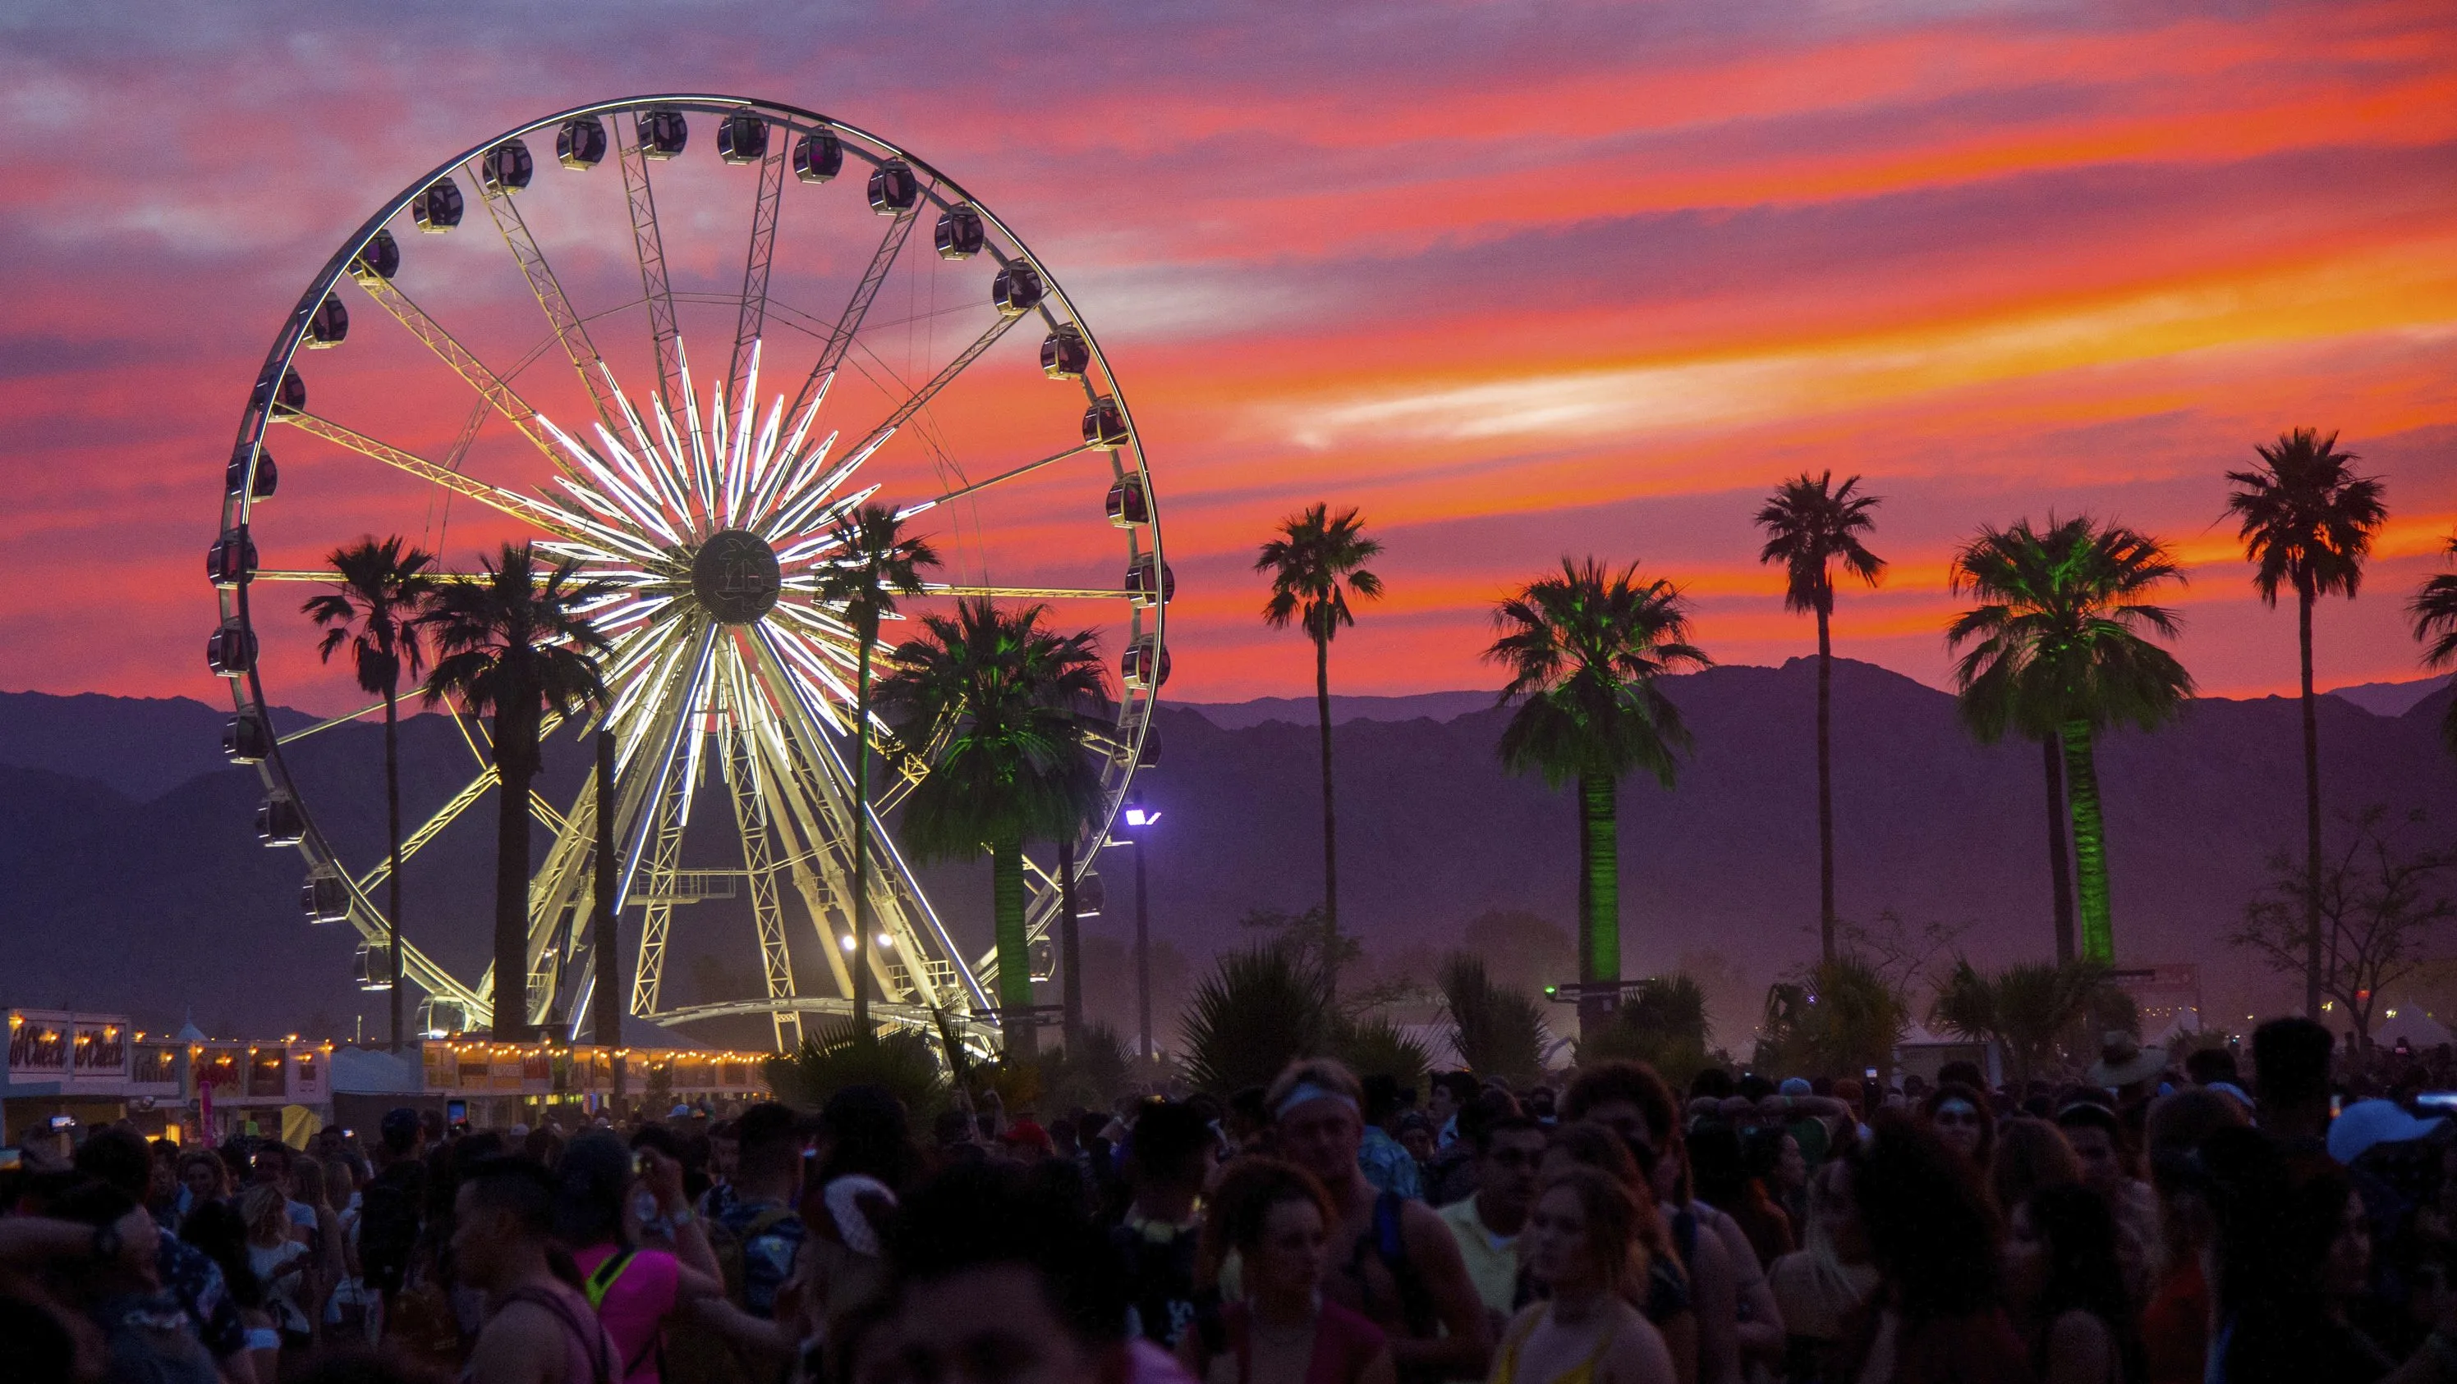

COCKTAIL & NETWORKING
DECEMBER 11TH
ROCK’N’ROLL FT HIP-HOP
POP FT ELECTRO
QUIZ
ROCK’N’ROLL FT POP
HIP-HOP FT ELECTRO
INTRO
FULL MASH UP
EXECUTION STAGE
ROCK’N’ROLL FT HIP-HOP
POP FT ELECTRO

Slide 12
COCKTAIL & NETWORKING
DECEMBER 11TH
ROCK’N’ROLL FT HIP-HOP
POP FT ELECTRO
QUIZ
ROCK’N’ROLL FT POP
HIP-HOP FT ELECTRO
INTRO
FULL MASH UP
POST-TRADE STAGE
ROCK’N’ROLL FT POP
HIP-HOP FT ELECTRO

Slide 13
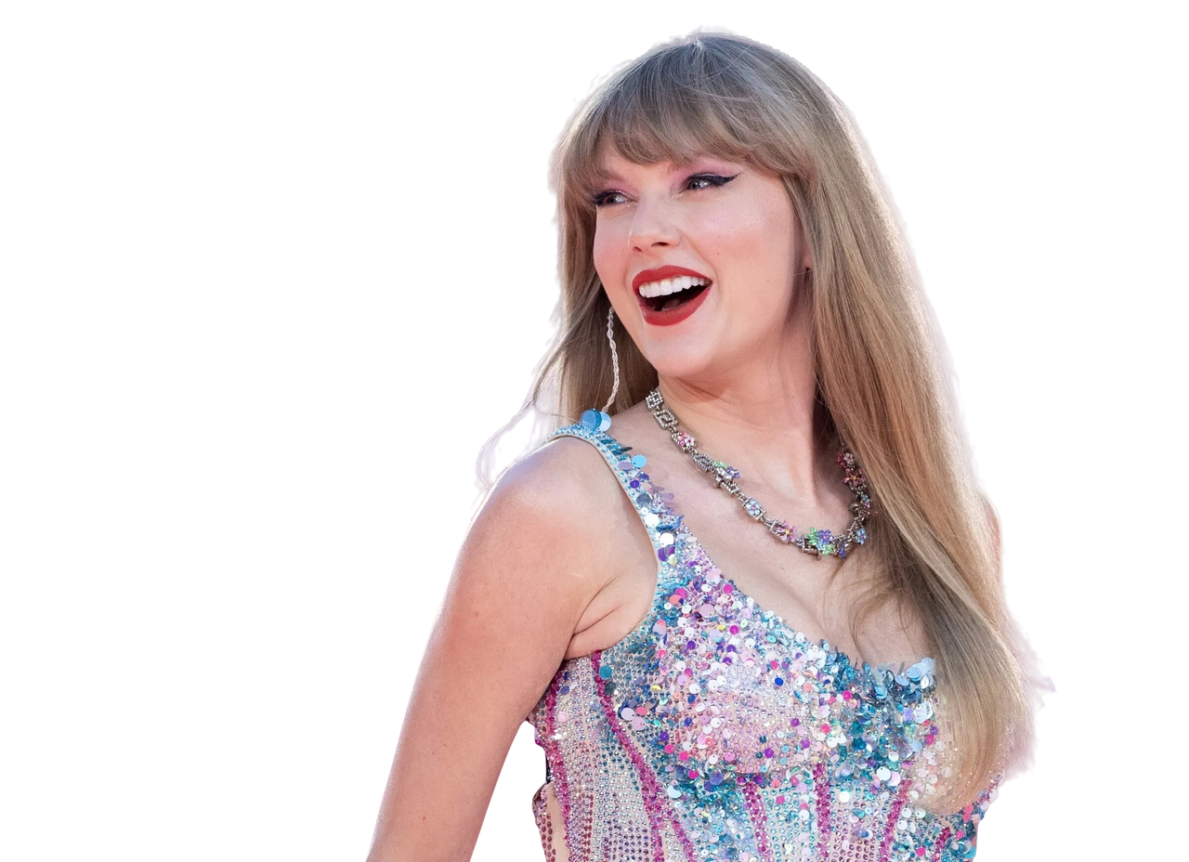
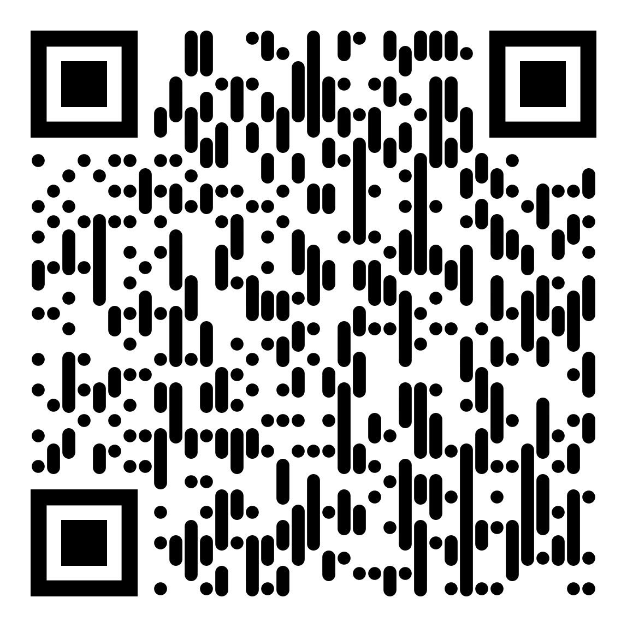
COCKTAIL & NETWORKING
DECEMBER 11TH
ROCK’N’ROLL FT HIP-HOP
POP FT ELECTRO
QUIZ
ROCK’N’ROLL FT POP
HIP-HOP FT ELECTRO
INTRO
FULL MASH UP
POST-TRADE STAGE
ROCK’N’ROLL FT POP
HIP-HOP FT ELECTRO

Slide 14
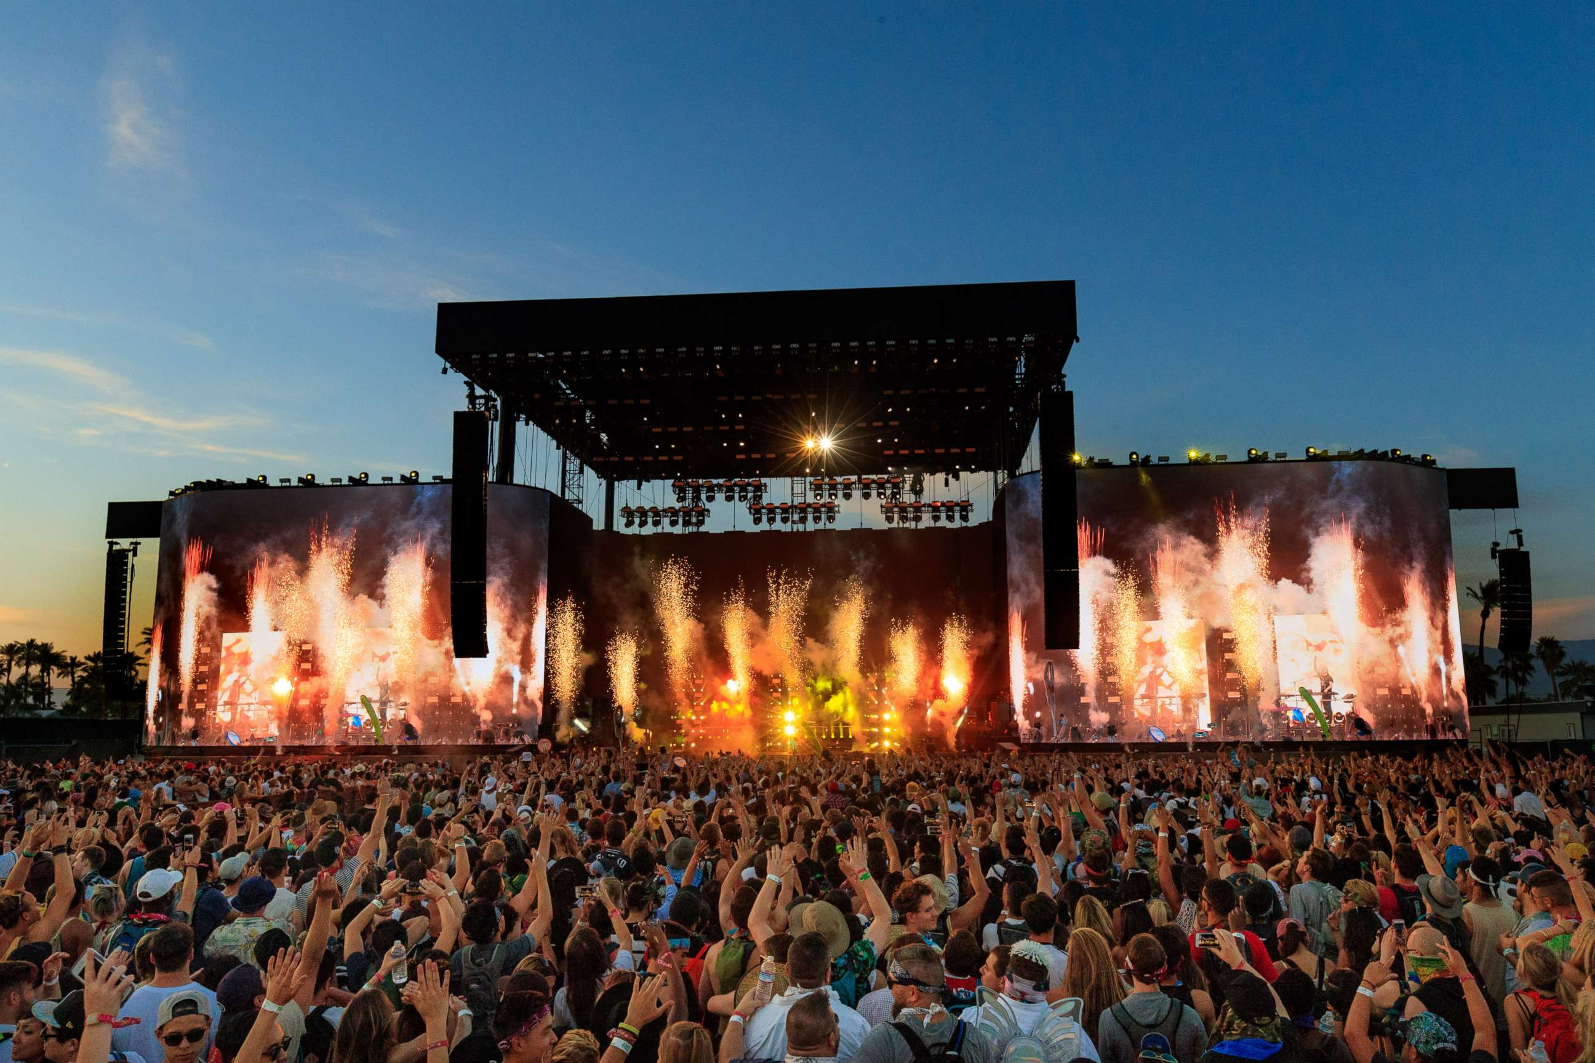
COCKTAIL & NETWORKING
DECEMBER 11TH
ROCK’N’ROLL FT HIP-HOP
POP FT ELECTRO
QUIZ
ROCK’N’ROLL FT POP
HIP-HOP FT ELECTRO
INTRO
FULL MASH UP
AFTER-HOURS STAGE
ROCK’N’ROLL FT
POP FT
HIP-HOP FT
ELECTRO
1
2
3
TEAM 1
1
2
3
4
5
6
TEAM 2
4
5
6
7
8
9
TEAM 3
7
8
9
10
11
12
TEAM 4
10
11
12

Slide 15
COCKTAIL & NETWORKING
DECEMBER 11TH
ROCK’N’ROLL FT HIP-HOP
POP FT ELECTRO
QUIZ
ROCK’N’ROLL FT POP
HIP-HOP FT ELECTRO
INTRO
FULL MASH UP
1
2
3
TEAM 1
1
2
3
AFTER-HOURS STAGE
ROCK’N’ROLL FT
POP FT
HIP-HOP FT
ELECTRO
4
5
6
TEAM 2
4
5
6
7
8
9
TEAM 3
7
8
9
10
11
12
TEAM 4
10
11
12

Slide 16
TEAM 1
TEAM 2
TEAM 3
TEAM 4

Slide 17
COCKTAIL & NETWORKING
DECEMBER 11TH
ROCK’N’ROLL FT HIP-HOP
POP FT ELECTRO
QUIZ
ROCK’N’ROLL FT POP
HIP-HOP FT ELECTRO
INTRO
FULL MASH UP
AFTER-HOURS STAGE
ROCK’N’ROLL FT
POP FT
HIP-HOP FT
ELECTRO

